Slide 1
Digital Logic Design I CS1026
Paula.Roberts@scss.tcd.ie

Slide 2
Basic Combinational Logic circuits
Sum Of Product (SOP) expressions are implemented using an AND gate for each product term and one OR gate for summing all of the product terms.
This is called AND-OR logic
It is the basic form for realizing standard Boolean functions
Note that AND-OR-Invert, Exclusive-OR and Exclusive-NOR are forms of AND-OR logic

Slide 3
Combinational Logic Circuits
In Sum-of-Products (SOP) form, basic combinational circuits can be directly implemented with AND-OR combinations if the necessary complement terms are available.

Slide 4
Combinational Logic Circuits
An example of an SOP implementation is shown. The SOP expression is an AND-OR combination of the input variables and the appropriate complements.
A
B
ABC
C
X = ABC
+ DE
SOP
D
E
DE

Slide 5
Combinational Logic Circuits
When the output of a SOP form is inverted, the circuit is called an AND-OR-Invert circuit. The AOI configuration lends itself to product-of-sums (POS) implementation.
An example of an AOI implementation is shown. The output expression can be changed to a POS expression by applying DeMorgan’s theorem twice.
A
B
ABC
C
X = ABC
+ DE
X = ABC
+ DE
AOI
D
X = (ABC)(DE)
DeMorgan
E
DE
X = (A + B + C)(D + E)
POS

Slide 6
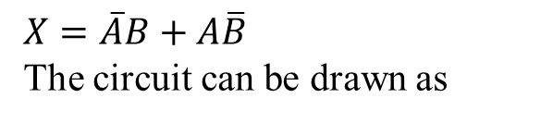
Exclusive-OR Logic
The truth table for an exclusive-OR gate is
Notice that the output is HIGH whenever A and B disagree.
The Boolean expression is
$X=\overline{A}B+A\overline{B}$ The circuit can be drawn as
A
Symbols:
X
Distinctive shape Rectangular outline
B

Slide 7

Exclusive-NOR Logic
The truth table for an exclusive-NOR gate is
Notice that the output is HIGH whenever A and B agree.
The Boolean expression is
$$\overline{A}\overline{B}+AB$$
The circuit can be drawn as
A
Symbols:
X
B
Distinctive shape Rectangular outline

Slide 8
Implementing Combinational Logic
Implementing a SOP expression is done by first forming the AND terms; then the terms are ORed together.
Example
Show the circuit that will implement the Boolean expression X = ABC + ABD + BDE. (Assume that the variables and their complements are available.)
Solution
Start by forming the terms using three 3-input AND gates.
Then combine the three terms using a 3-input OR gate.
A
B
C
A
X = ABC + ABD + BDE
B
D
B
D
E

Slide 9
Karnaugh Map Implementation
For basic combinational logic circuits, the Karnaugh map can be read and the circuit drawn as a minimum SOP.
Example
A Karnaugh map is drawn from a truth table. Read the minimum SOP expression and draw the circuit.
Solution
1. Group the 1’s into two overlapping groups as indicated.
Read each group by eliminating any variable that changes across a boundary.
B changes across this boundary
The vertical group is read A C.
C changes across this boundary
The horizontal group is read AB.
The circuit is on the next slide:

Slide 10
Solution
continued…
Circuit:
A
C
X =
A
C
+
A
B
A
B
The result is shown as a sum of products.
It is a simple matter to implement this form using only NAND gates as shown in the text and following example.

Slide 11
NAND Logic
Example
Convert the circuit in the previous example to one that uses only NAND gates.
Solution
Recall from Boolean algebra that double inversion cancels. By adding inverting bubbles to above circuit, it is easily converted to NAND gates:
A
C
X =
A
C
+
A
B
A
B

Slide 12
Universal Gates
NAND gates are sometimes called universal gates because they can be used to produce the other basic Boolean functions.
A
A
A
AB
B
Inverter
AND gate
A
A
A + B
A + B
B
B
OR gate
NOR gate

Slide 13
Universal Gates
NOR gates are also universal gates and can form all of the basic gates.
A
A
A
A + B
B
Inverter
OR gate
A
A
AB
AB
B
B
AND gate
NAND gate

Slide 14
NAND Logic
Recall from DeMorgan’s theorem that AB = A + B. By using equivalent symbols, it is simpler to read the logic of SOP forms. The earlier example shows the idea:
A
C
X =
A
C
+
A
B
A
B
The logic is easy to read if you (mentally) cancel the two connected bubbles on a line.

Slide 15
NOR Logic
Alternatively, DeMorgan’s theorem can be written as A + B = A B. By using equivalent symbols, it is simpler to read the logic of POS forms. For example,
A
B
X =
(A + B)(A + C)
A
C
Again, the logic is easy to read if you cancel the two connected bubbles on a line.

Slide 16

Coffee shop problem
Amy, Cedric, Kathy, and Marmaduke, the buyers of Jamaican Blue Mountain coffee beans for the "RedEye Coffee Company", have designed a complex voting system to decide when to buy new beans. Design and implement a digital logic system that they can use to indicate whether they should buy new beans. A “buy” order is placed if:
Amy, Kathy, and Marmaduke vote NO and Cedric votes YES,
or Amy and Marmaduke vote NO and the rest vote YES,
or Cedric and Marmaduke vote YES and the rest vote NO,
or Amy votes NO and the others vote YES,
or Cedric votes NO and the others vote YES,
or Cedric and Amy vote YES and the others vote NO,
or Kathy votes NO and the others vote YES,
or Marmaduke votes NO and the others vote YES,
or Amy and Kathy vote YES and the others vote NO,
or they all vote YES.

Slide 17
Coffee shop problem
Write down a Boolean expression below that has 4 Boolean inputs, A, C, K, M, corresponding to the initials of the bean buyers and a Boolean output BUY.
Using a Karnaugh map, minimise the circuit.
Show that the Boolean expression for the minimised logic is given by C+AK

Slide 18
Coffee shop problem
Prove that Marmaduke has no influence whatsoever on the vote, that is, the minimised logic does not contain M
Implement the minimised circuit using logic gates
Think carefully about what you are going to do regarding Marmaduke’s button

Slide 19
Pulsed Waveforms
For combinational circuits with pulsed inputs, the output can be predicted by developing intermediate outputs and combining the result. For example, the circuit shown can be analyzed at the outputs of the OR gates:
A
A
G₁
B
B
C
G₃
C
D
G₂
D
G₁
G₂
G₃

Slide 20
Pulsed Waveforms
Inputs
Output
Alternatively, you can develop the truth table for the circuit and enter 0’s and 1’s on the waveforms. Then read the output from the table.
A B C D
X
0 0 0 0
0
0 0 0 1
1
A
0 0 1 0
1
G₁
0 0 1 1
1
B
0 1 0 0
0
G₃
C
0 1 0 1
1
G₂
0 1 1 0
1
D
0 1 1 1
1
1 0 0 0
0
A
0 1 0 1 0 1 0 1 0 1
1 0 0 1
0
0 1 1 0 0 1 1 0 0 0
1 0 1 0
0
B
1 0 1 1
0
C
0 0 0 1 1 1 1 0 0 0
1 1 0 0
0
1 1 0 1
1
D
0 0 0 0 0 0 0 1 1 0
1 1 1 0
1
G₃
0 0 0 0 1 1 1 0 1 0
1 1 1 1
1

Slide 21
Examples
Use AND gates, OR gates or combinations of the two to implement the following logic expressions
X=AB
X=A+B
X=AB+C
X=ABC+D
X=A+B+C
X=ABCD
X=A(CD+B)
X=AB(C+DEF)+CE(A+B+F)

Slide 22
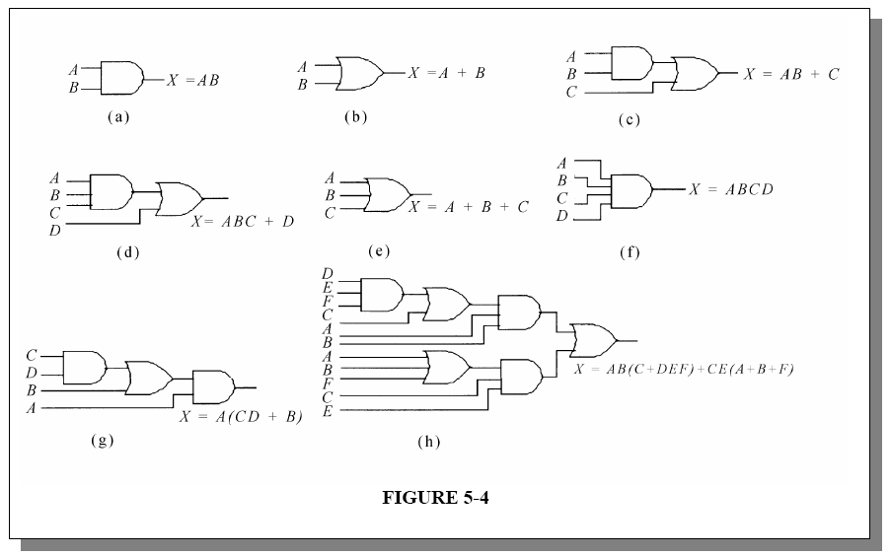
Examples

Slide 23
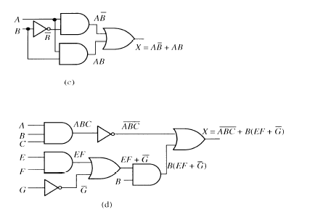
Examples

Slide 24
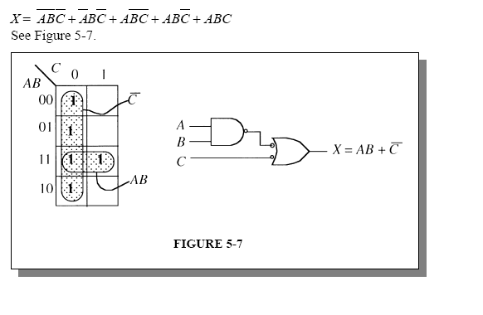
Examples
Implement and minimise the Boolean expression below

